Slide 1



Slide 2


Slide 3
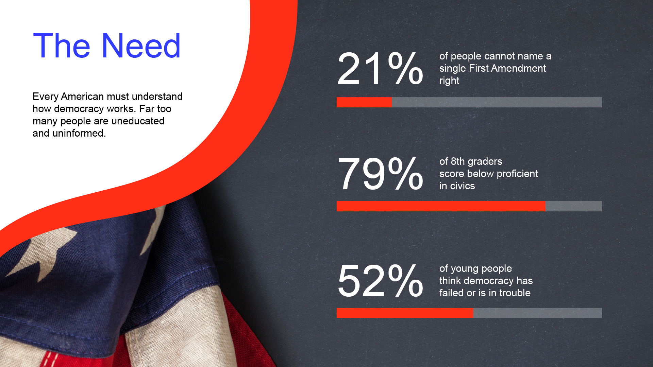

Slide 4
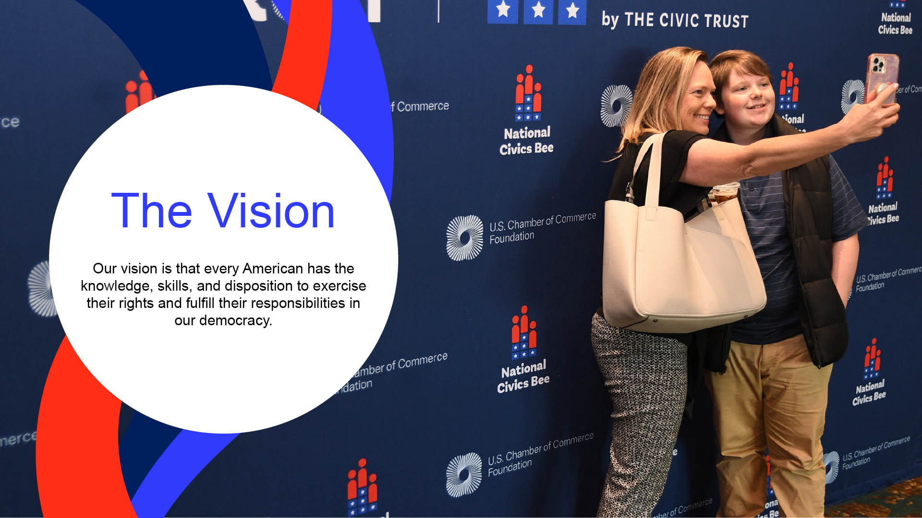

Slide 5
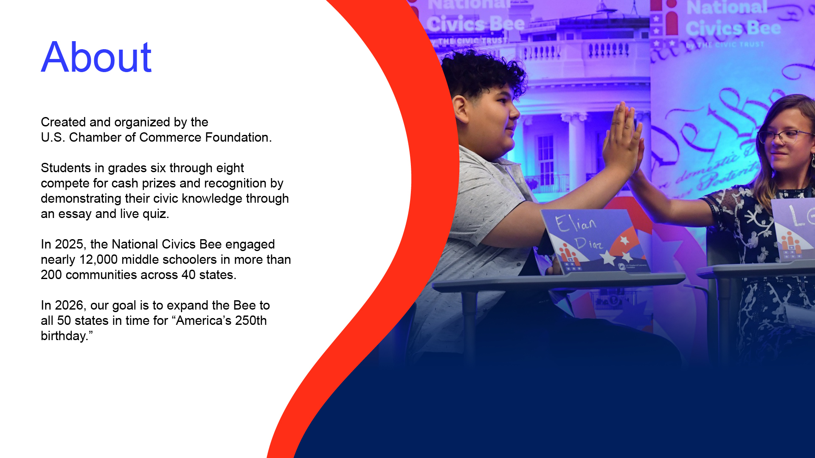

Slide 6

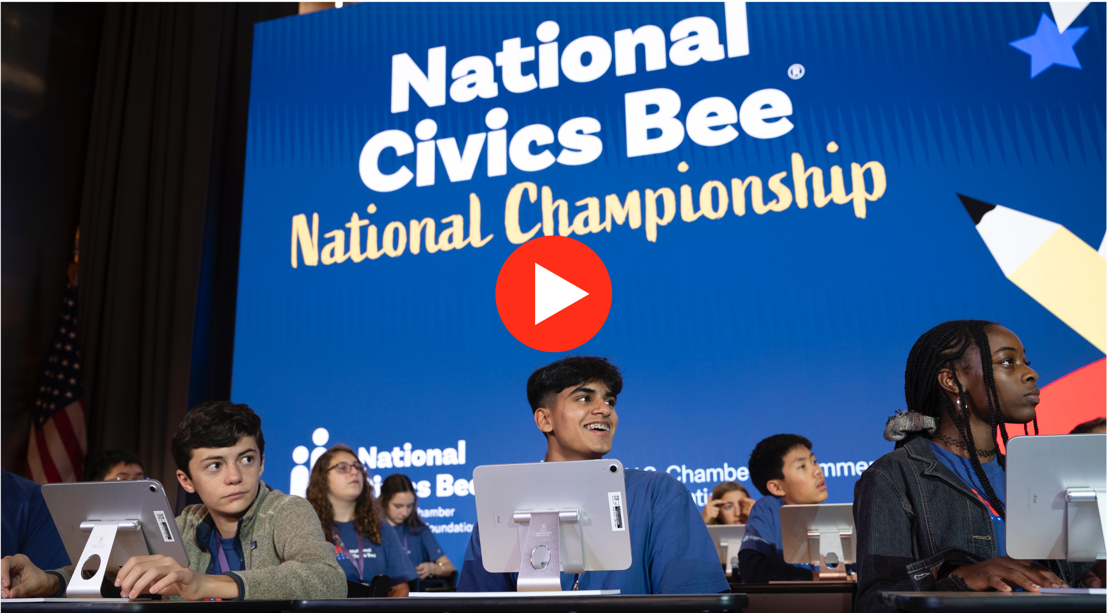

Slide 7
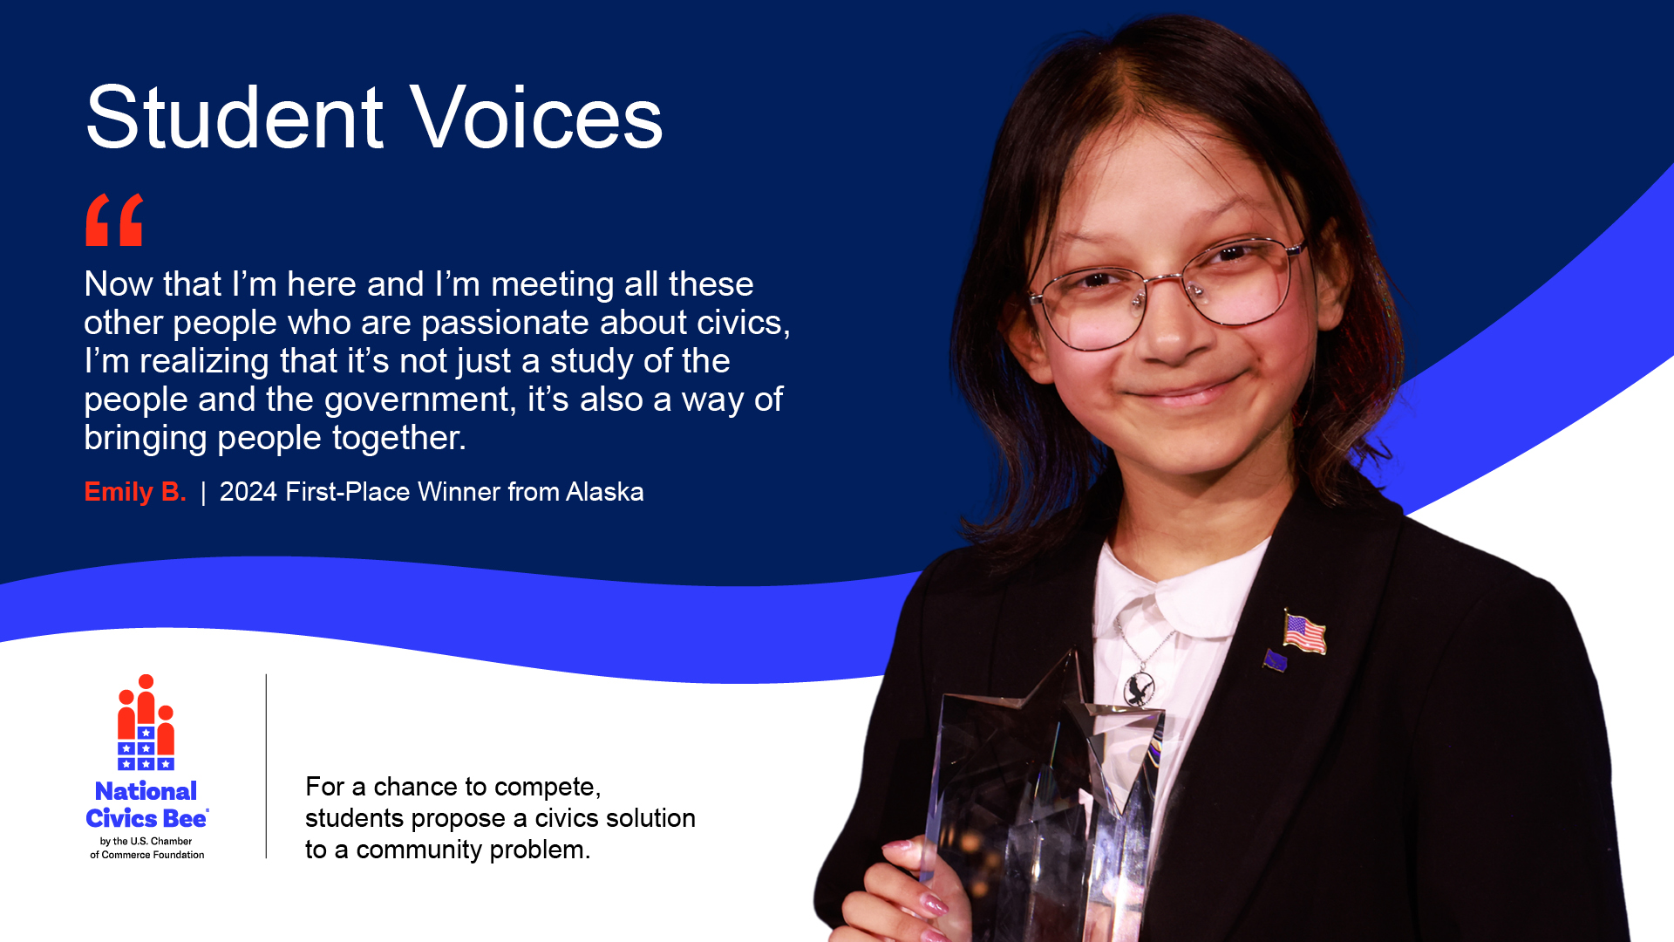

Slide 8
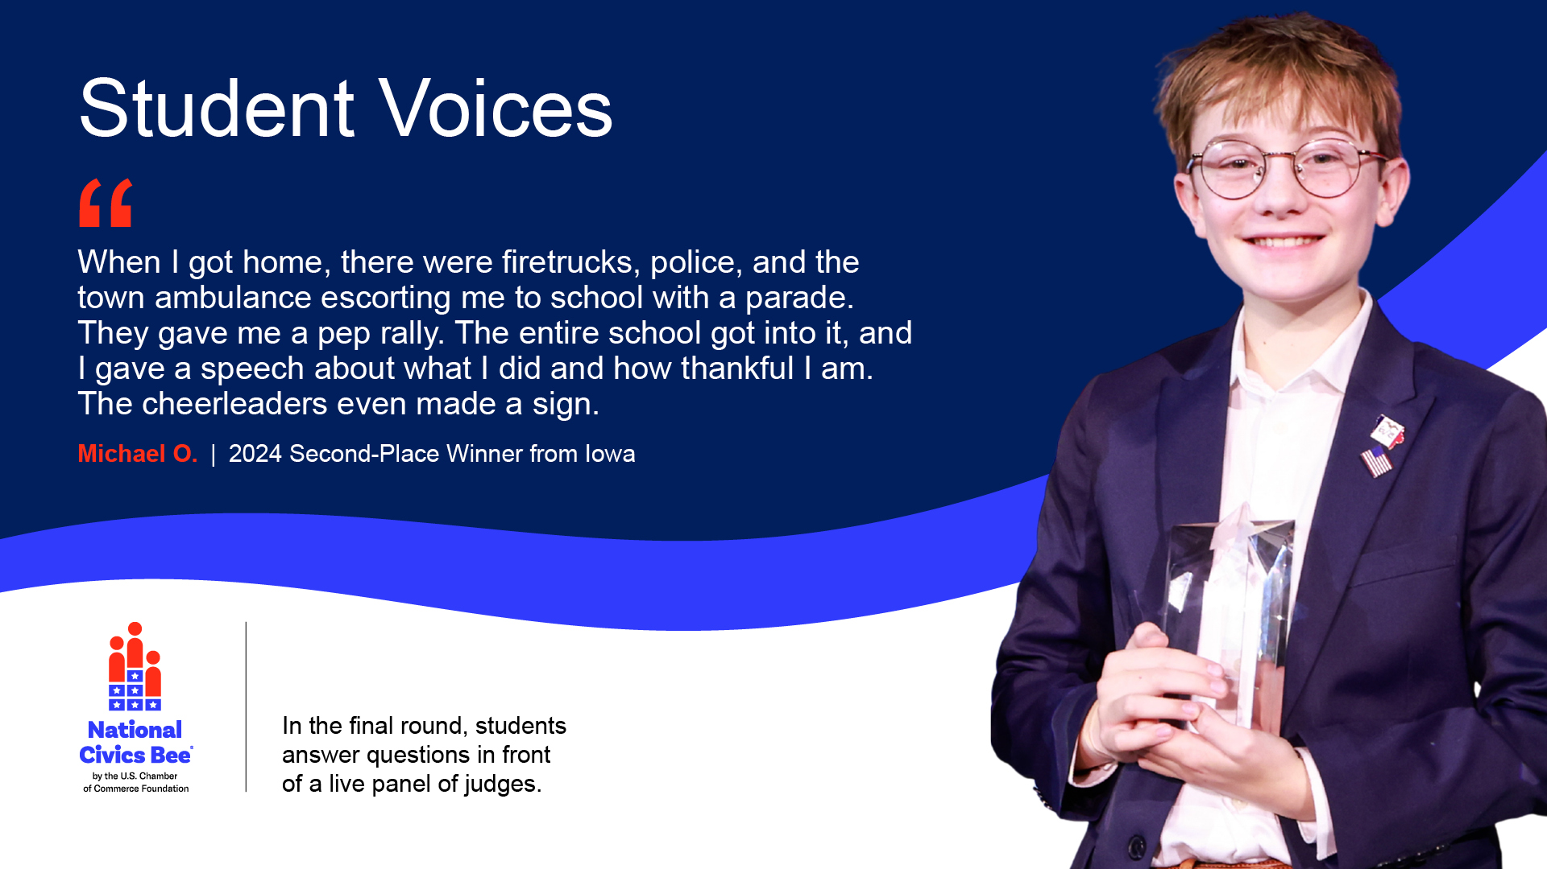

Slide 9
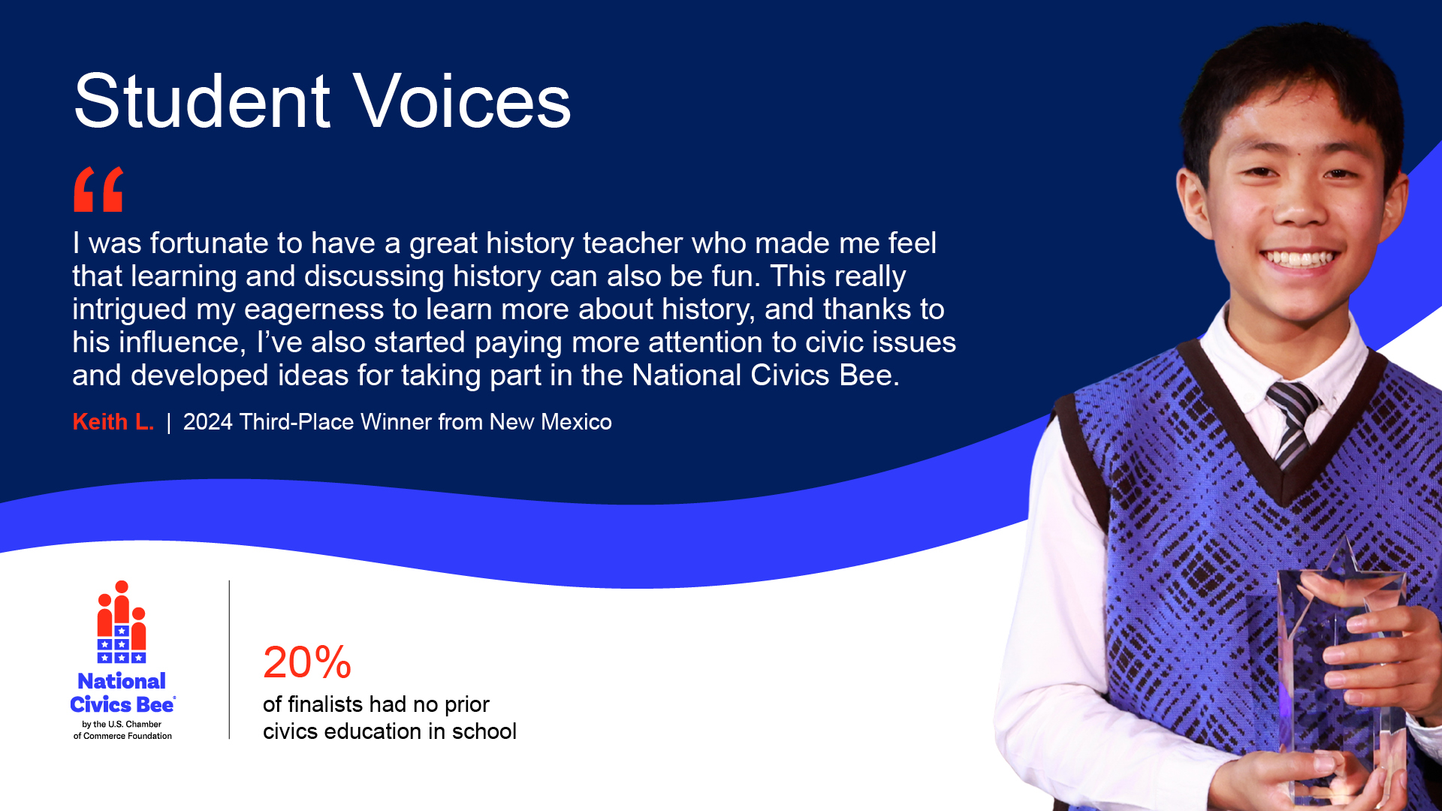

Slide 10
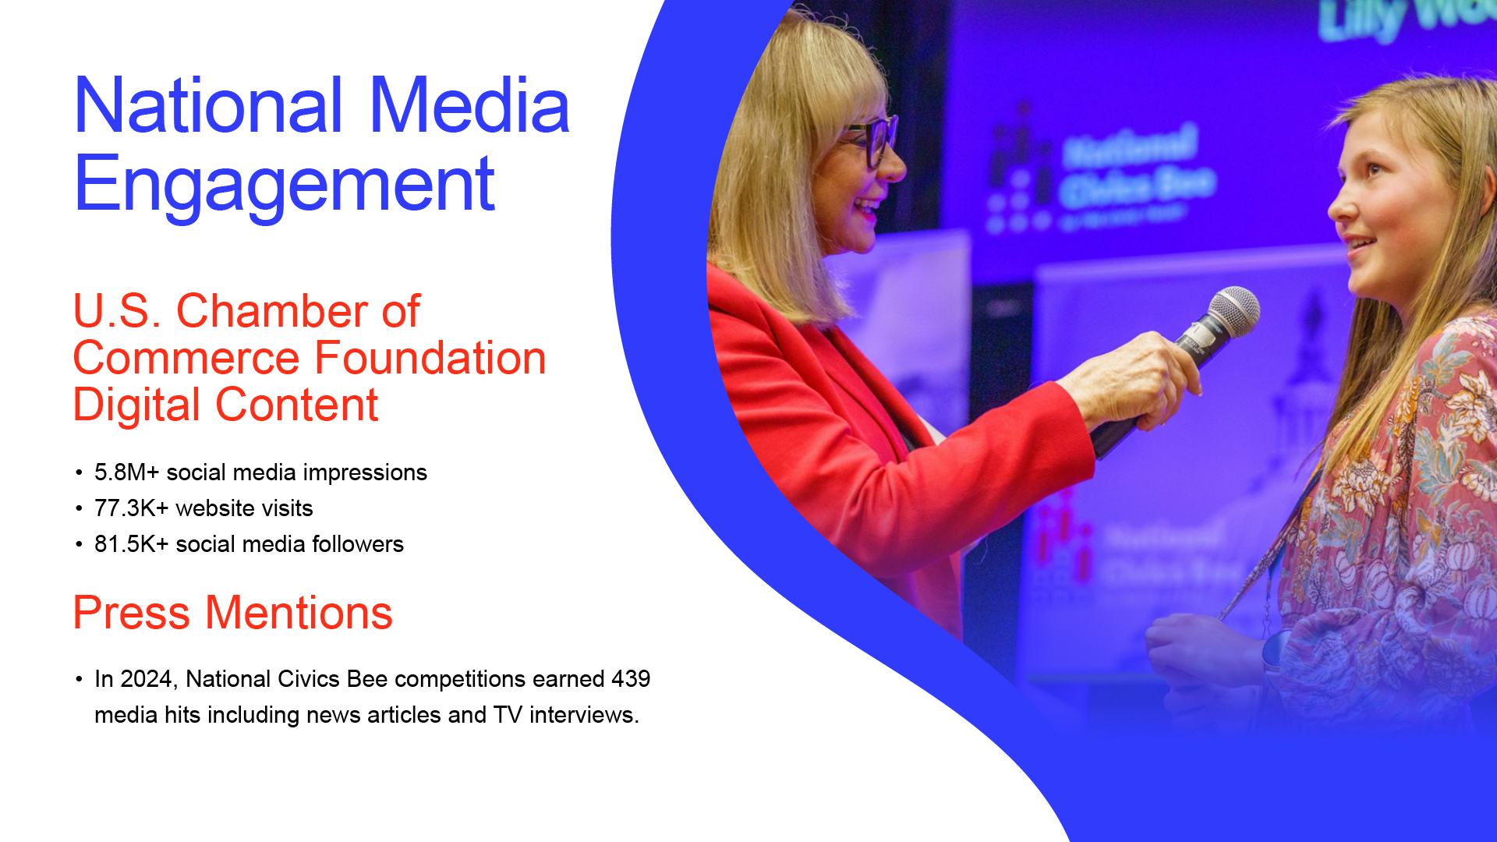

Slide 11

New York State Competition Hosted By The Business Council of New York State, Inc.
  Wednesday, July 1, 2026
  10:00 a.m. – 12:30 p.m.
  Albany Capital Center

Slide 12
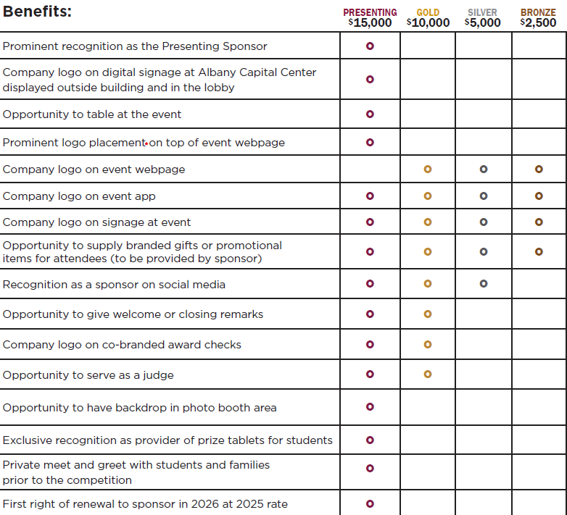
New York State Sponsorship Opportunities
SOLD OUT

Slide 13

518-694-3843
LinkedIn
Danielle.Gormley@ppinys.org
www.ppinys.org
111 Washington Avenue, Suite 400
Albany, New York 12210

Slide 14


